Slide 2
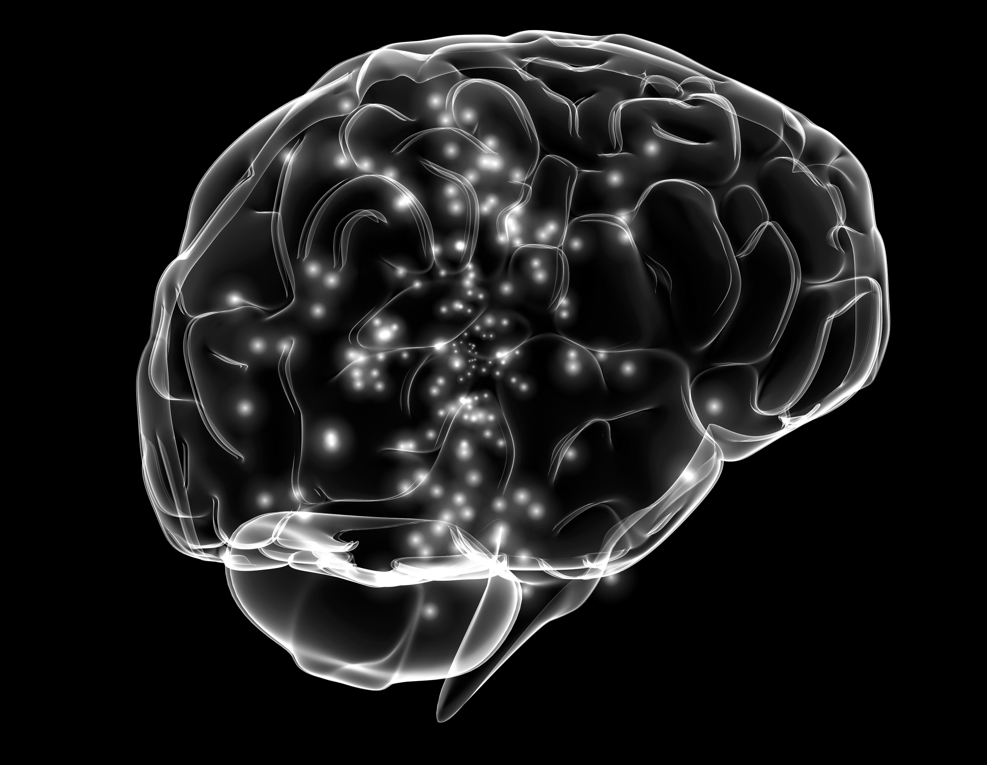


:
Srinakharinwirot University
May 04, 2017
Assoc. Prof. Bundit Thipakorn
Deputy Secretary-General for Higher Education Commission

Slide 3
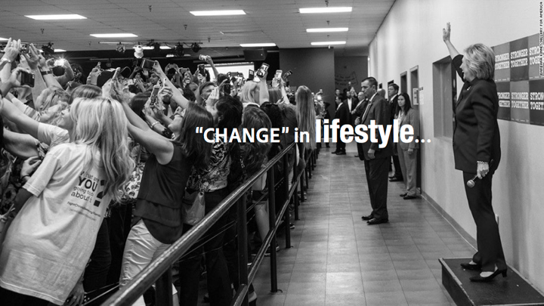



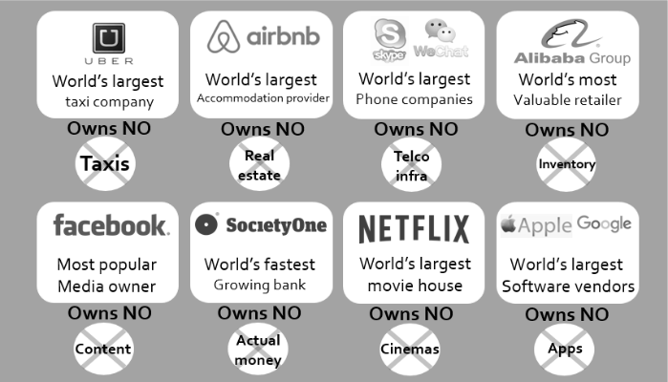

Slide 4


unpredictable
anything can happen …

Slide 5
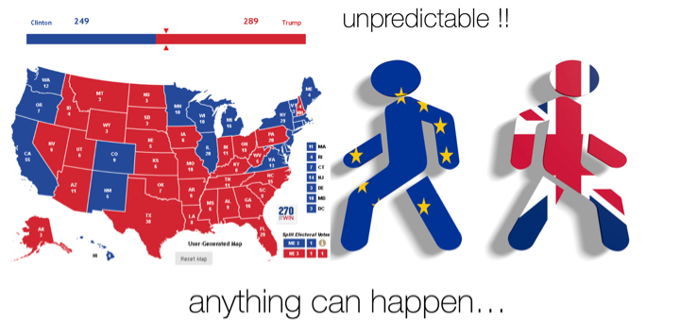

Slide 6

thailand
4.0 ?

Slide 7
WISDOM
INTELLIGENCE
smart
collective
DIGITAL
INNOVATION
openness
4.0
normal is not good enough
collaboration
generation/age
COCREATION
massive
CONNECTIVITY
sharing
of everything
for ALL
interaction

Slide 8

4.0 ?

Slide 9



Slide 10

4.0

Slide 11




Slide 12
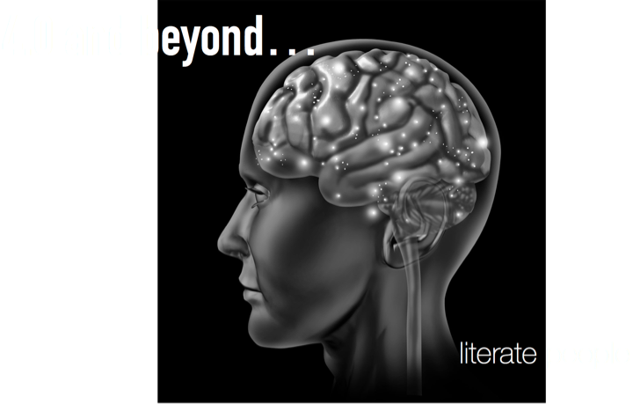


Slide 13
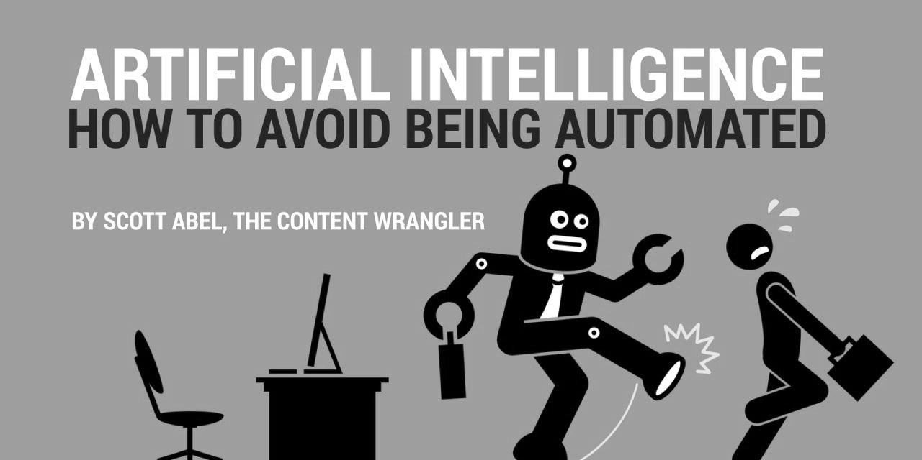

Slide 14
ARTIFICIAL INTELLIGENCE ISN’T JUST A BLUE COLLAR THREAT

Slide 15

how do you feel about this quote ?

Slide 16
JOBS WILL BE ELIMINATED…
NOT
“WORK”

Slide 17
ANYWORK
THAT
CANNOT
be
Automated
Digitised
or
…

Slide 18
will become
VALUABLE

Slide 19
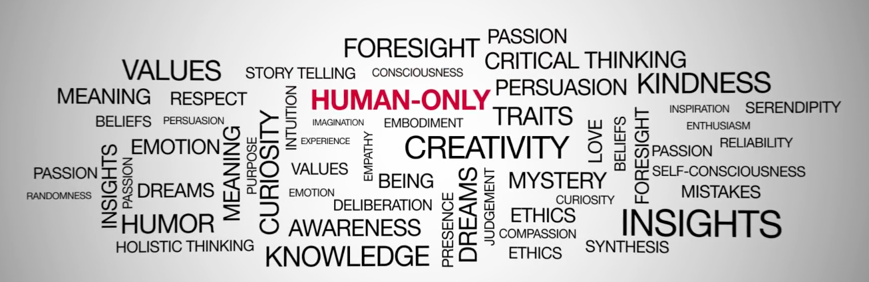

Slide 20


Slide 21
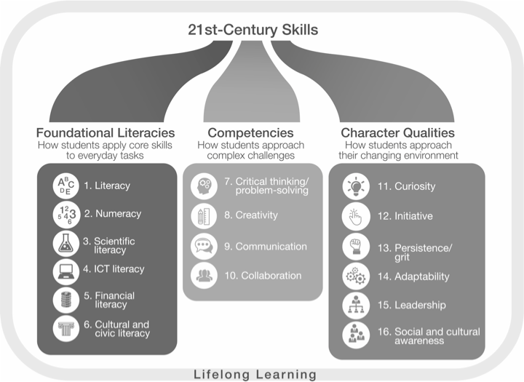

Slide 22
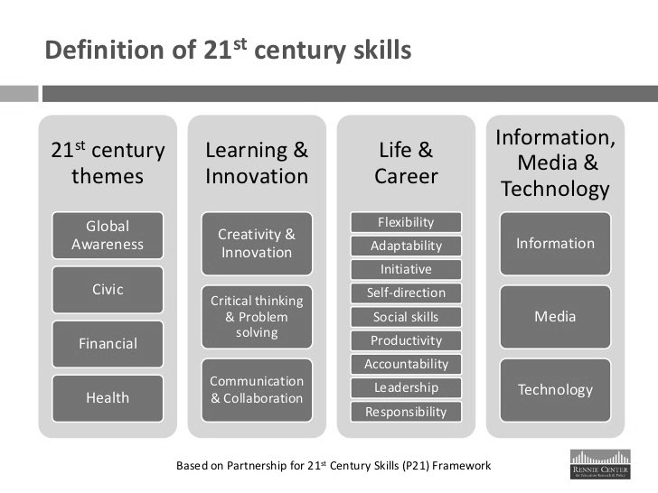

Slide 23


Slide 24


Slide 25


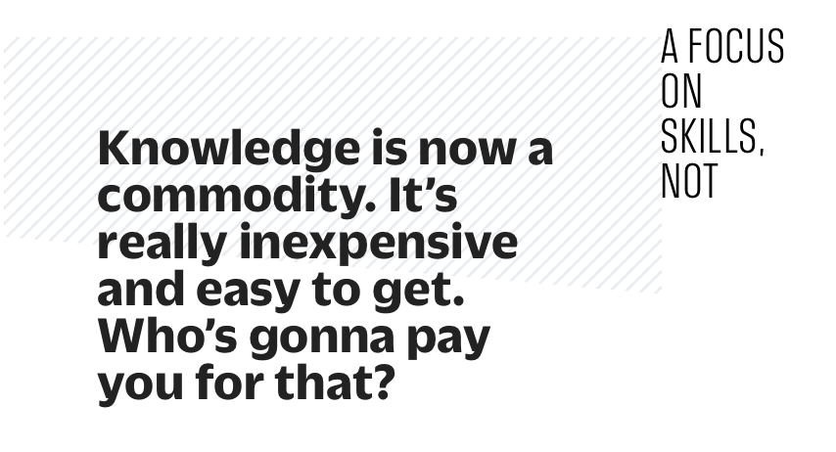

Slide 26
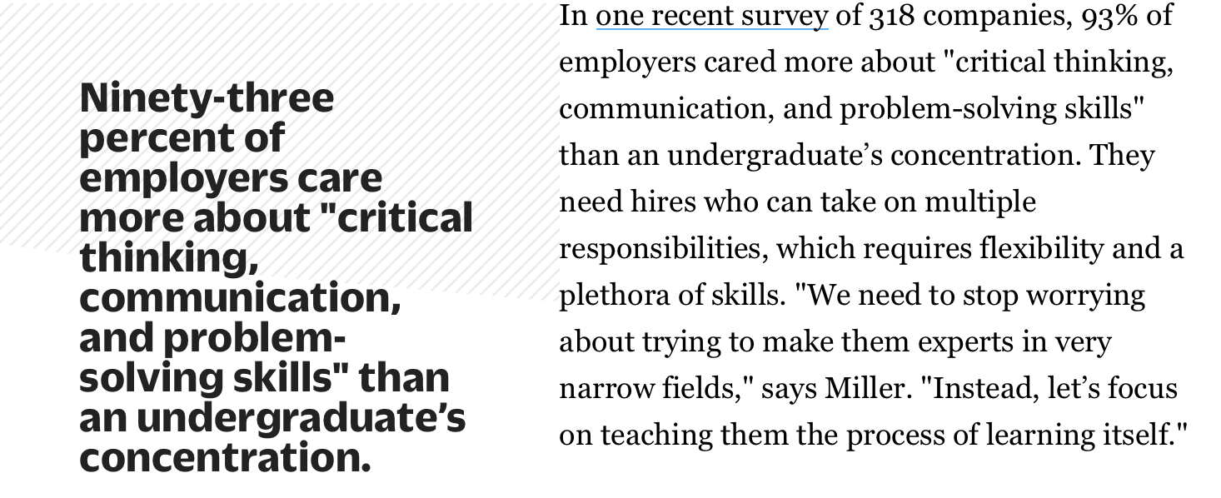


Slide 27
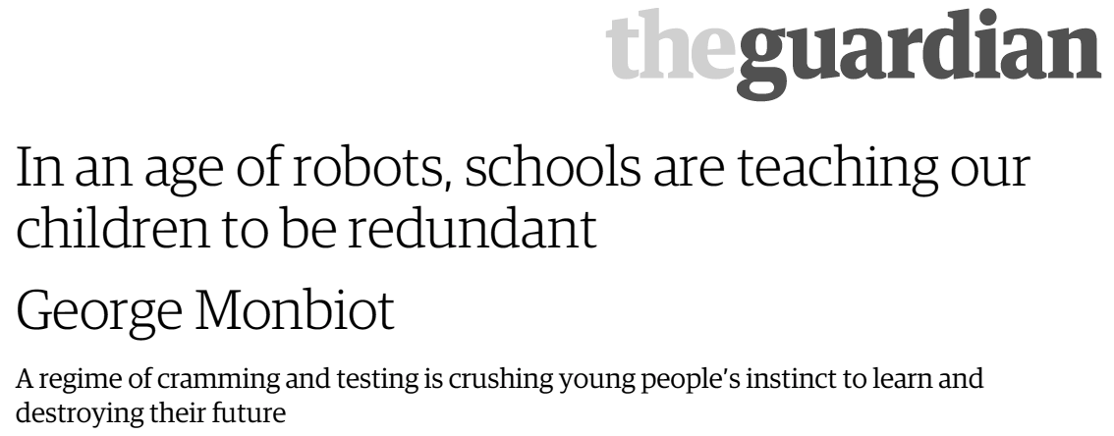

Slide 28

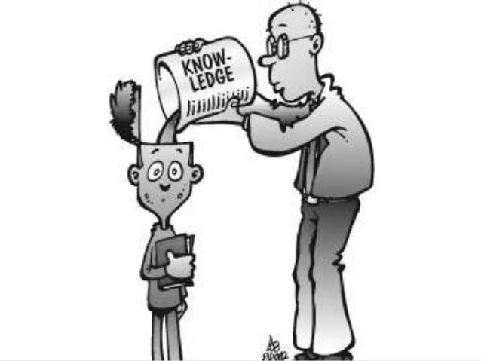


it is not the reason why “students” have to come to university any more…

Slide 29




this piece of paper cannot ensure the “success” of our student in the age of Thailand 4.0…
Intellectual
Nutrition
Fact

Slide 30


Slide 31


Slide 32


Save
Our
Students

Slide 33
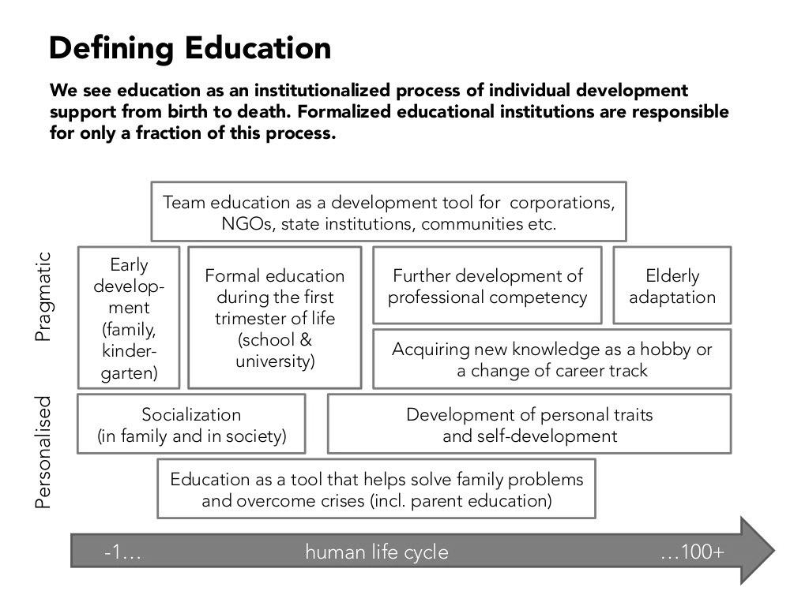

Slide 34
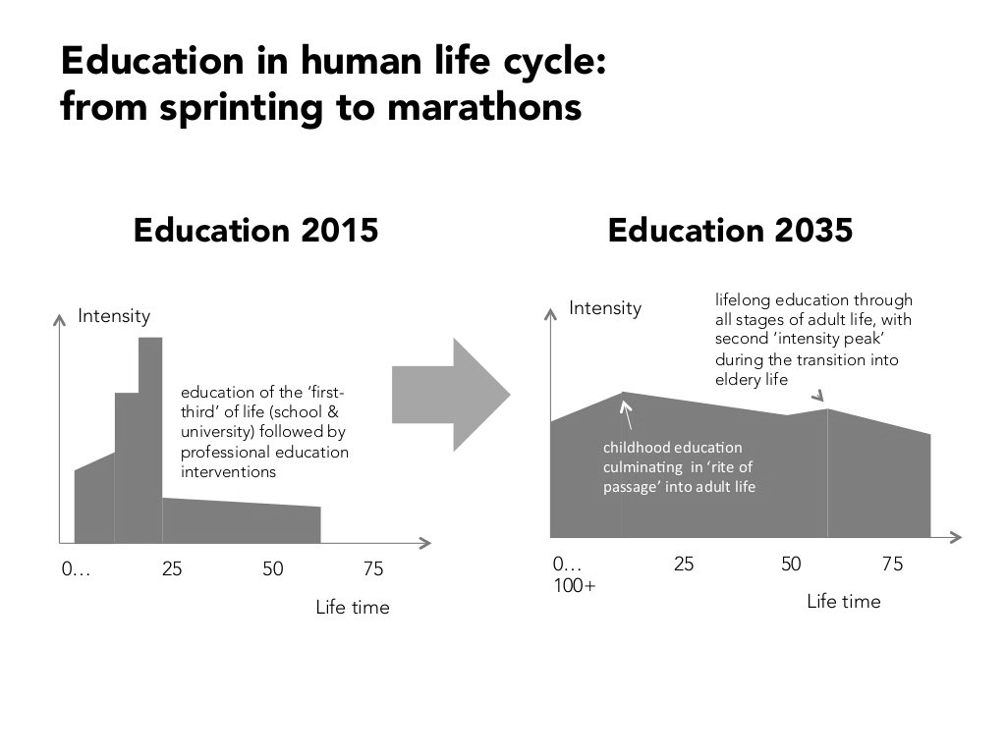

Slide 35
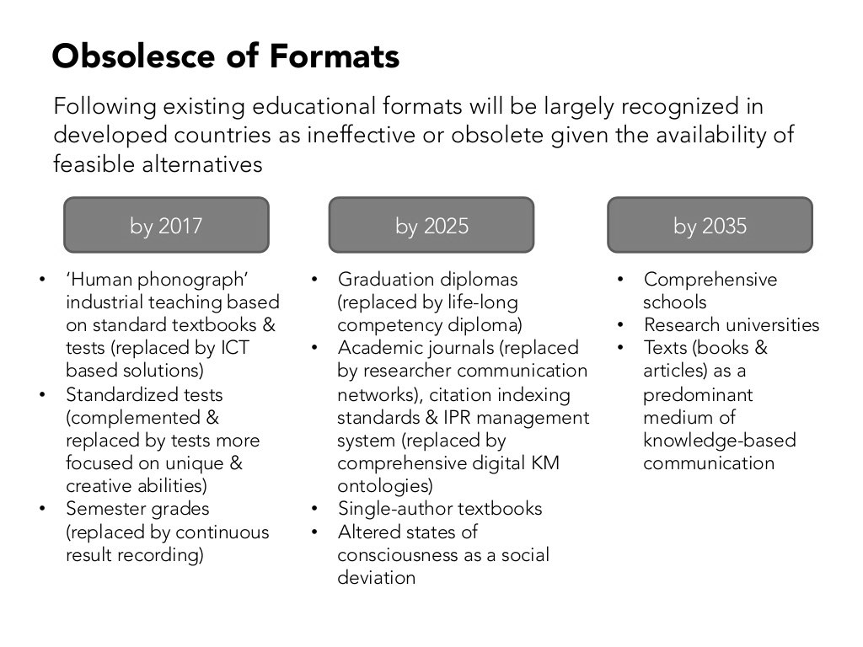

Slide 36
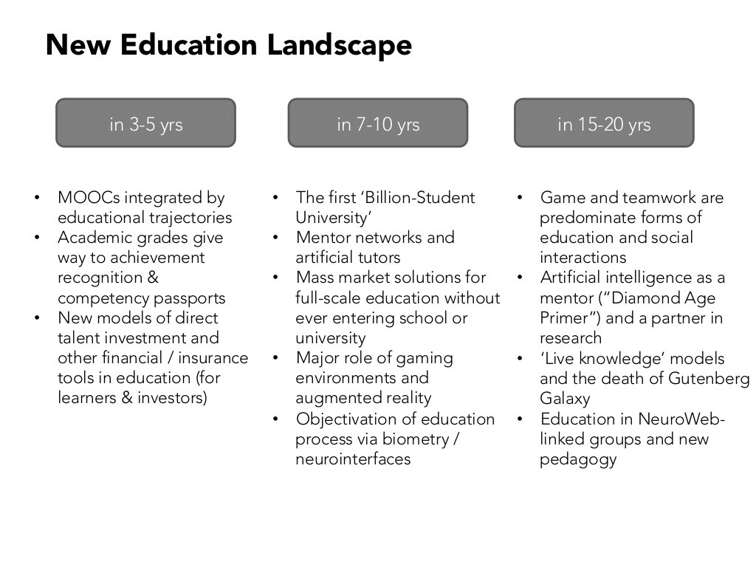

Slide 37


how “formal education” can be a “platform” for “life-long learning; lll” of graduates…

Slide 38
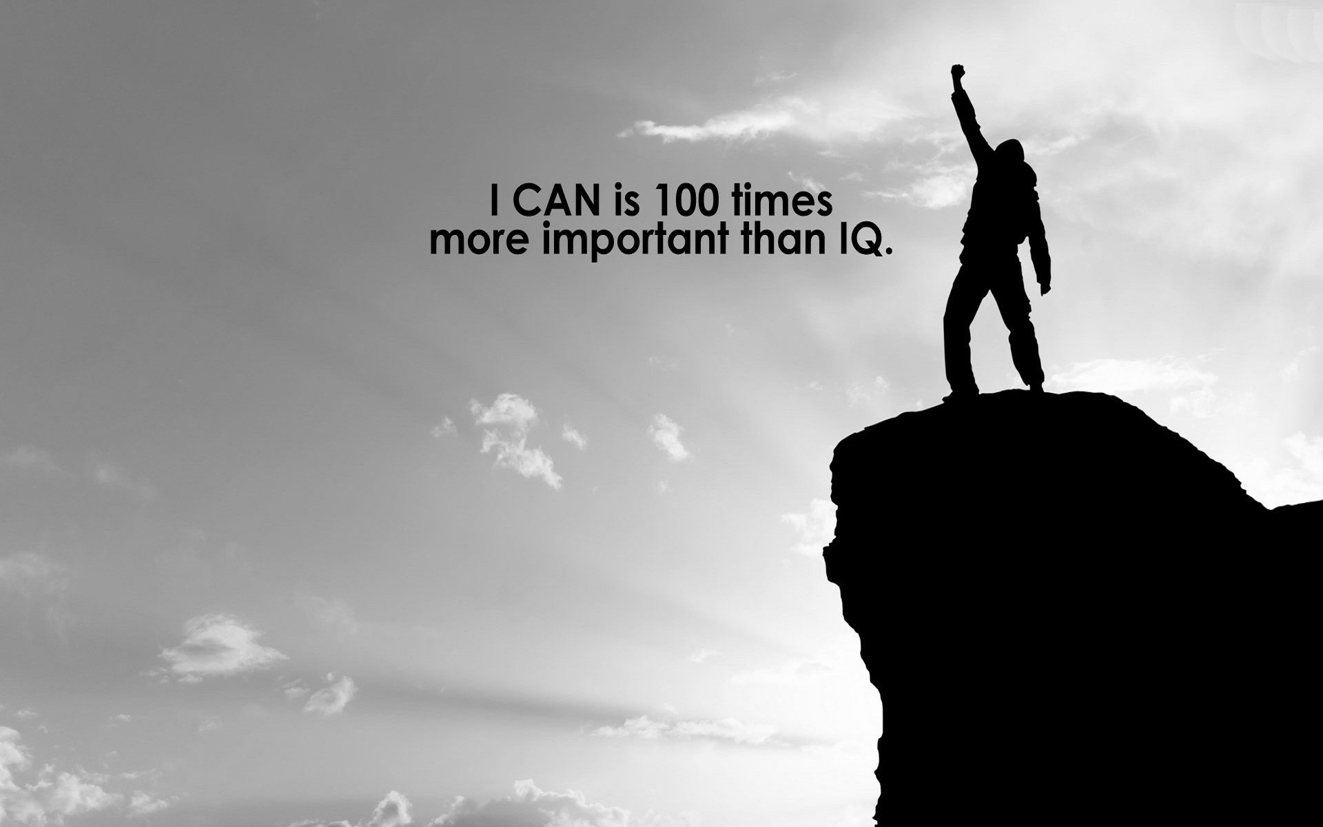

ensuring
“know”
“be able to do”
and
“trainable”
competent scholar
LEARNING
“COMPETENCE”
happens
not CLAIMS
during studying

Slide 39

wisdom is “meta-knowledge” of what to know, how much, and what to do with it which is developed from deep experience across multiple contexts over many years of deliberate practice…

Slide 41
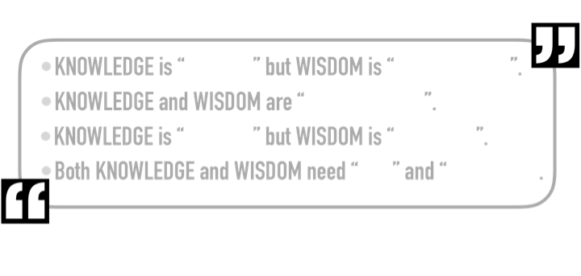

Slide 43
Data: the raw building blocks; it consists of raw numbers, but lack context or meaning. 1,200, 9.6%, and $170k are all piece of data.
Information: the application of structure or order to data, in an attempt to communicate meaning. Knowing the S&P500 is at 1,200 (up 5% YTD), Unemployment is at 9.6% (down from 11%), and GDP is 2.5% (revised from 2%) are examples.
Knowledge: an understanding of a specific subject, through experience (or education). Typically, knowledge is used in terms of a persons skills or expertise in a given area. Knowledge typically reflects an empirical, rather than intuitive, understanding. Plato referenced it as “justified true belief.”
Wisdom: optimum judgment, reflecting a deep understanding of people, things, events or situations. A person who has wisdom can effectively apply perception and knowledge in order to produce desired results. Comprehending objectively reality within a broader context.

Slide 44

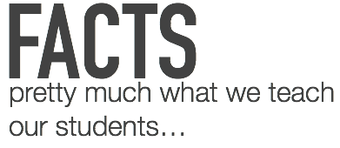
Wisdom is the recognition that knowledge patterns arise from fundamental principles and the understanding of what those principles are.
Wisdom
understanding, applying, applying with compassion
understanding “principles”
Knowledge is represented by patterns among data, information, and possibly other knowledge. These patterns do not provide knowledge until they have been understood.
Knowledge
interpreting, integrating, understanding…
context independent
understanding “patterns”
Information represented by relationships between data and the data sources to make it meaningful.
Information
organizing, interpreting…
understanding “relations”
Data
name, collecting, organizing…
understanding
Data is an item out of context with no relation with other things.

Slide 46
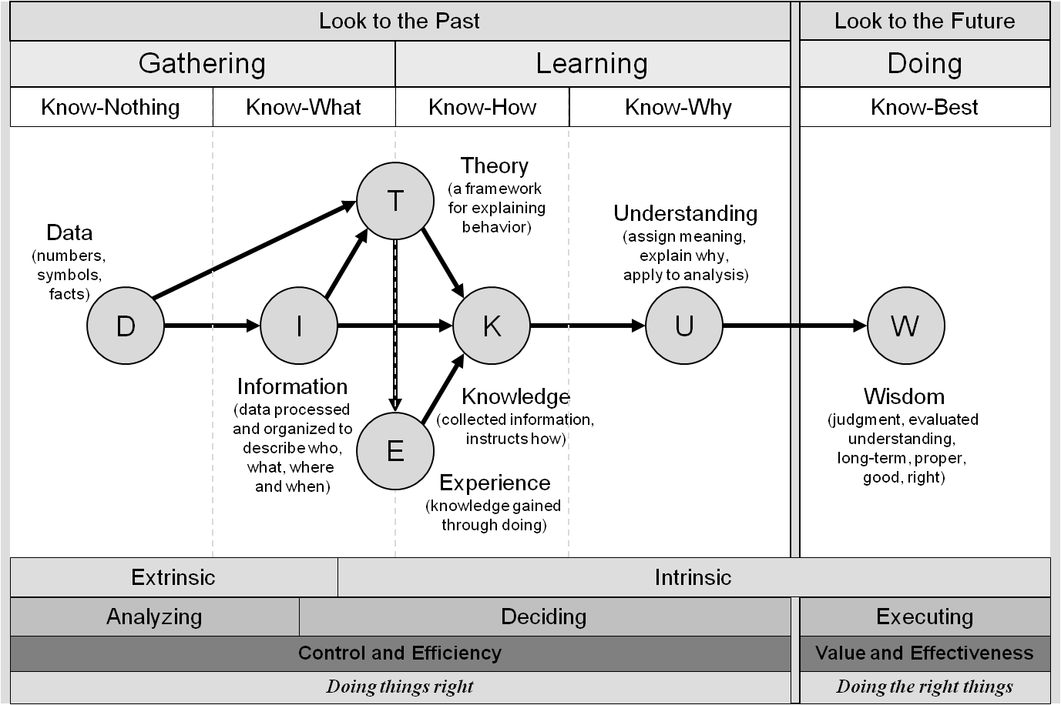

Slide 47
Do you know now how
WISDOM
can be developed in your class ?

Slide 48


Slide 49
What is Creativity?
original and of high quality (Perkins, 1981, p. 6)
a simple concept that can be difficult to get your head around…
ability to imagine or invent something new…
not a synonym for clever, humorous, artistically pleasing, enthusiastic, or persuasive …

Slide 50


Slide 51
“if you train yourself, and there are different methods for doing this, you can become more creative.”
- Rom Schrift
“mind-wandering seems to be essential to the creative process…”
- Scott Barry Kaufman

Slide 53
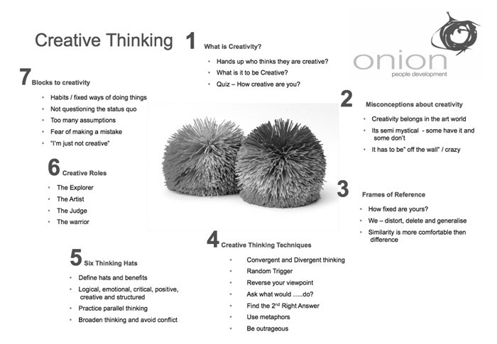

Slide 54
Creative student:
Recognize the importance of a deep knowledge base and continually work to learn new things.
Are open to new ideas and actively seek them out.
Find source material in a wide variety of media, people, and events.
Organize and reorganize ideas into different categories or combinations and then evaluate whether the results are interesting, new, or helpful.
Use trial and error when they are unsure how to proceed, viewing failure as an opportunity to learn. (Brookhart, 2010, pp. 128–129) …

Slide 55


Slide 56
N
O
EXISTING
in our education system …

Slide 57
This is
what you need to do

Slide 58
student must
LEARN
to
“understand”
and
“FAIL”

Slide 59
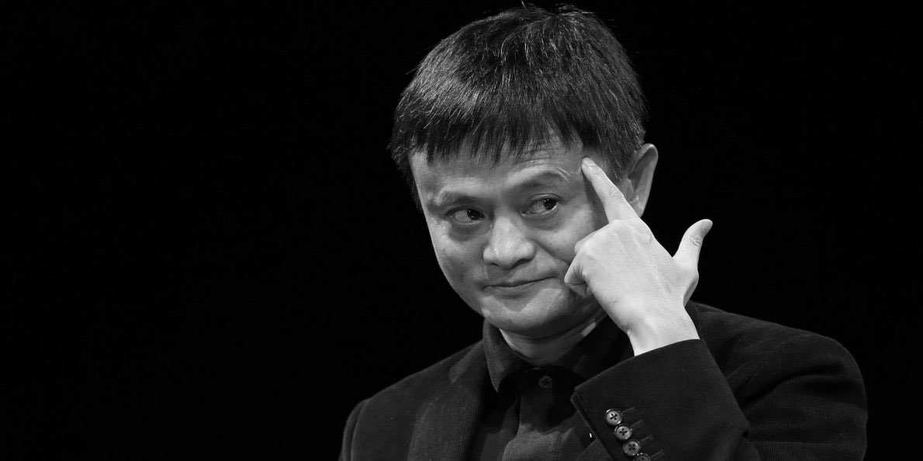

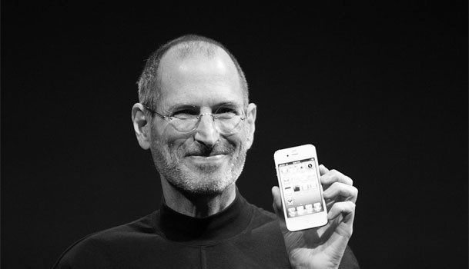


Slide 60



mind
training of the
to
THINK
the underline is…

Slide 61

through many experiences…

Slide 62
”
HOW
can we make it happen…
“

Slide 63
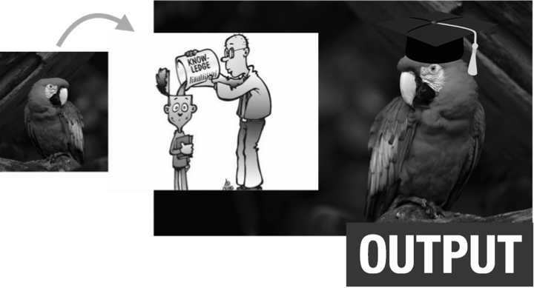
it is time to quit this “knowledge transfer” process…

Slide 64

WHAT
to
TEACH
TEACH
ING
with
HOW
WHAT
material
to
TEACH
TEACH
to

Slide 65

concepts
through

Slide 66

“what is the SIGNIFICANT learning” for students to know, be able to do, or values (their accomplishment)?”…
“PERFORMANCE not topics (what a student should be able to do in order successfully to complete the programme)”.
ect…
“why should students take these core courses?”…

Slide 68
what does the cupcake look like?

Slide 70

did you see the concept of your programme?

Slide 71
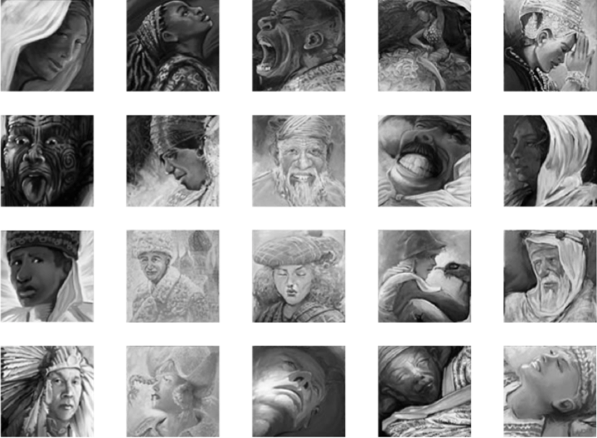
building blocks of learning (enabling outcomes)…

Slide 72
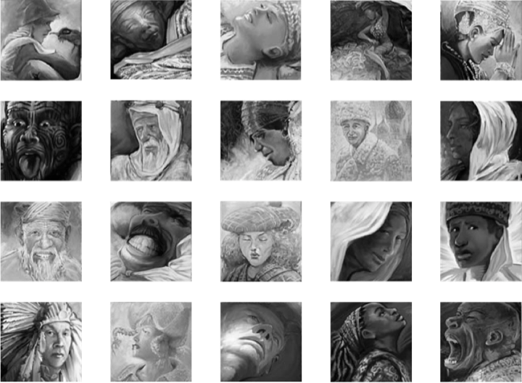
time is not the issue …
time varies but learning outcome fix…

Slide 73
HOW
STUDENT
learn?

Slide 74
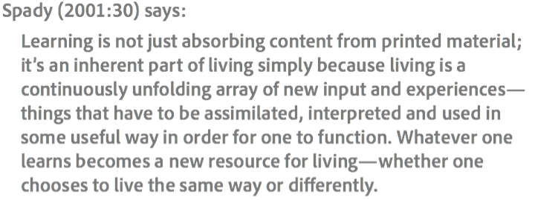
WHY IT
ENGAGEMENT
MATTERS
is a key…

Slide 75
learning is both a process and an outcome …
learning is is something that students do and it is the result of that they do …
learning results in changes in understanding, these changes in understanding enable learners to change their behaviour …
learning can be considered as largely a cognitive process (something that involves thinking) but one that may be linked to the development of skills and which can be influenced by affective (emotional) and contextual factors…

Slide 76



Slide 77
”
guide on the side; not sage on the stage
be part of learning process
be expert learner
design learning process
no “SET” procedures/recipes
help the students construct their own knowledge …
“

Slide 78


Slide 79



Slide 80

University (and teachers) control many of the conditions that determine whether or not students are successful at school learning.
learning environment
believing
Successful learning promotes even more successful learning
All students can learn and succeed, but not all in the same time or in the same way.
high quality of teaching
differentiate learning

Slide 81


the concept/big picture students must understanding as a result of their learning …

Slide 82
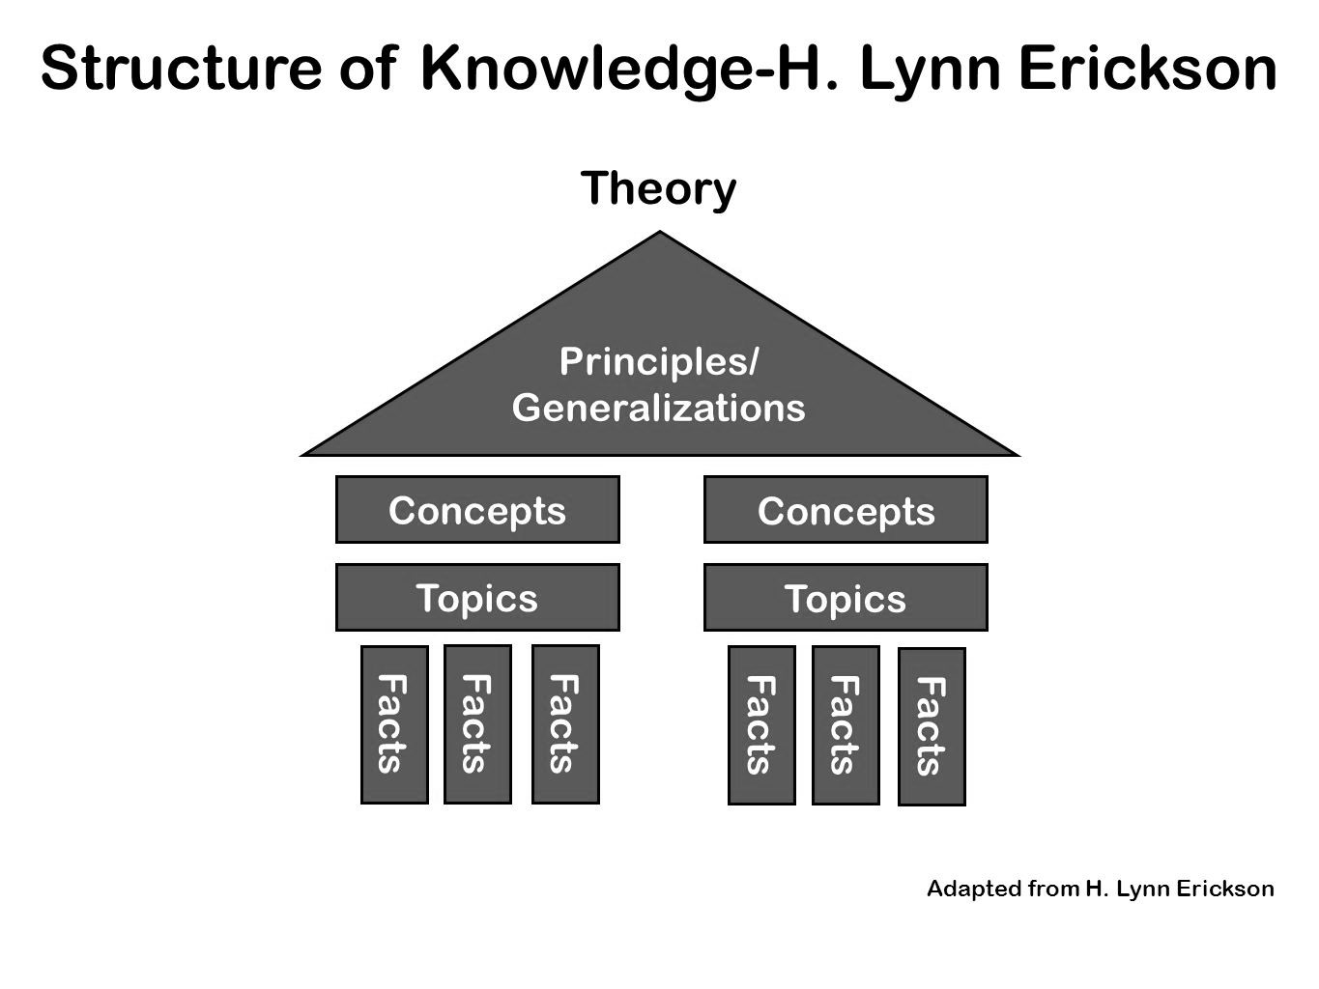
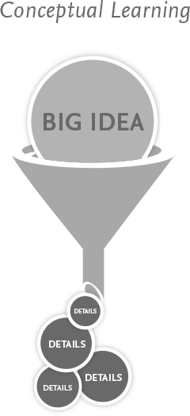
understanding

Slide 83
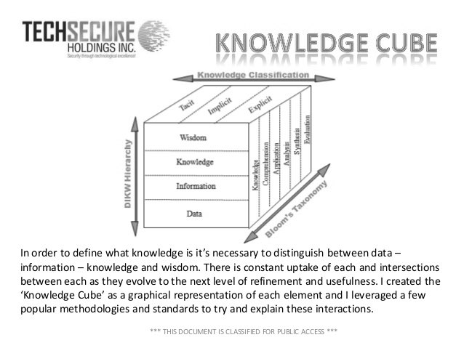

Slide 84
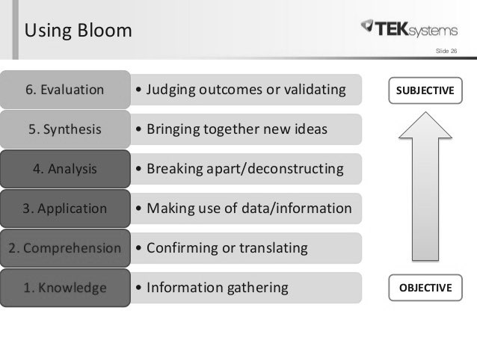

Slide 85
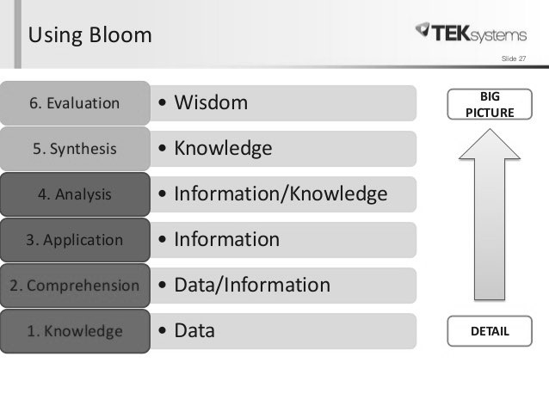

Slide 86
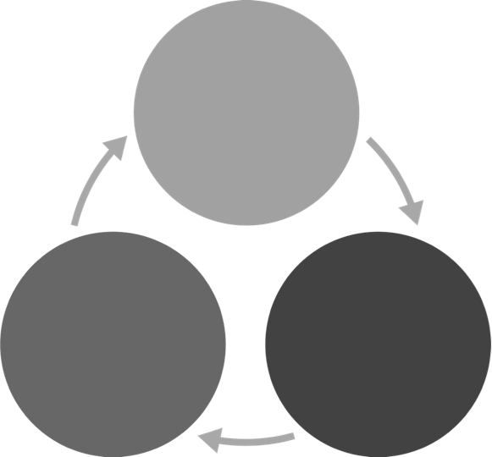


WHAT
DO
student can
“LEARNING OUTCOME”
with
WHAT
HOW
activities
HOW
and
to
ASSESS
TEACH
to

Slide 87



“WHAT” is important for students to be able to do (their “ACHIEVEMENT” )…
you must have a clear understanding of
“WHAT”
“HOW”
teacher must design “HOW” to make sure such learning ultimately “HAPPENS”…
would you like to
“ASSESS”
from your students’
“performance”

Slide 88
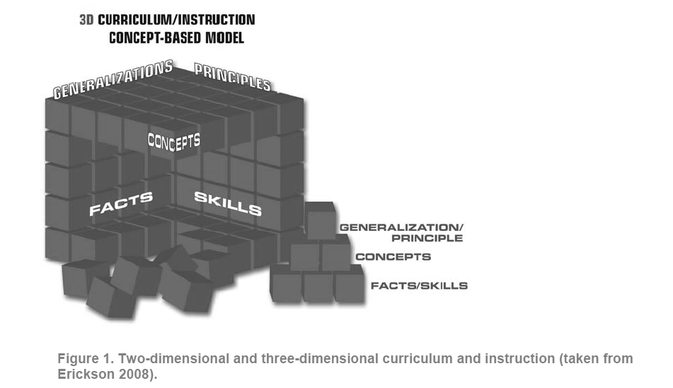
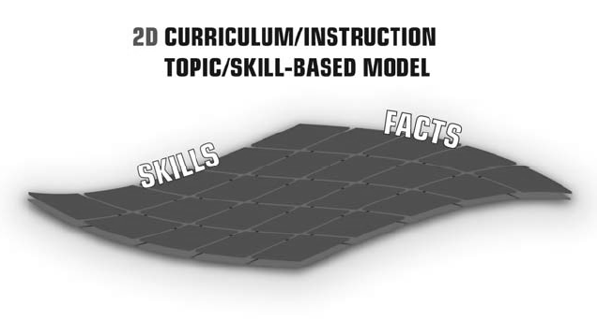
use “facts” and “skills” as “tools” to gain deep understanding…

Slide 90
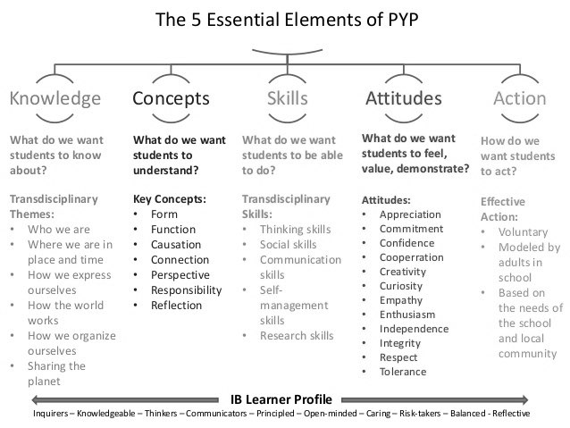

Slide 91

instruct student to understand main concepts
coach or facilitate student to connect each main concept
reflect on how student forms his/her own pattern…
supervise -> form the pattern
instruct -> understand
main concept
instruct -> understand
main concept
coach -> connect
instruct -> understand
instruct -> understand
main concept
main concept
instruct -> understand
main concept

Slide 92
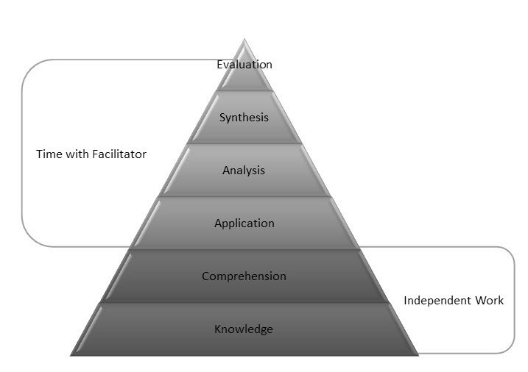

Slide 93
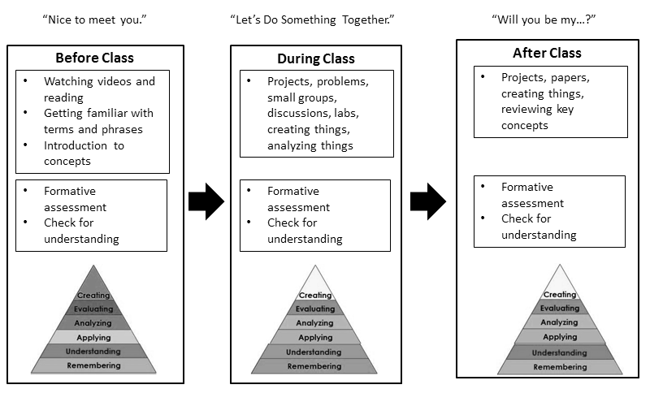

Slide 94
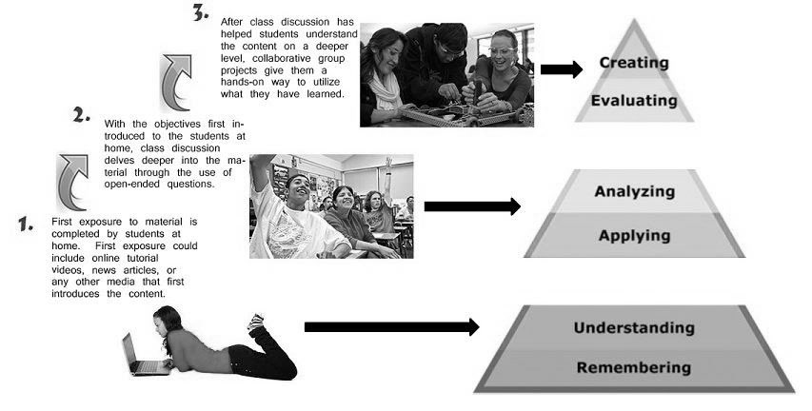

Slide 95

CHALLENGE
ACITIVITIES/TASKS

Slide 96
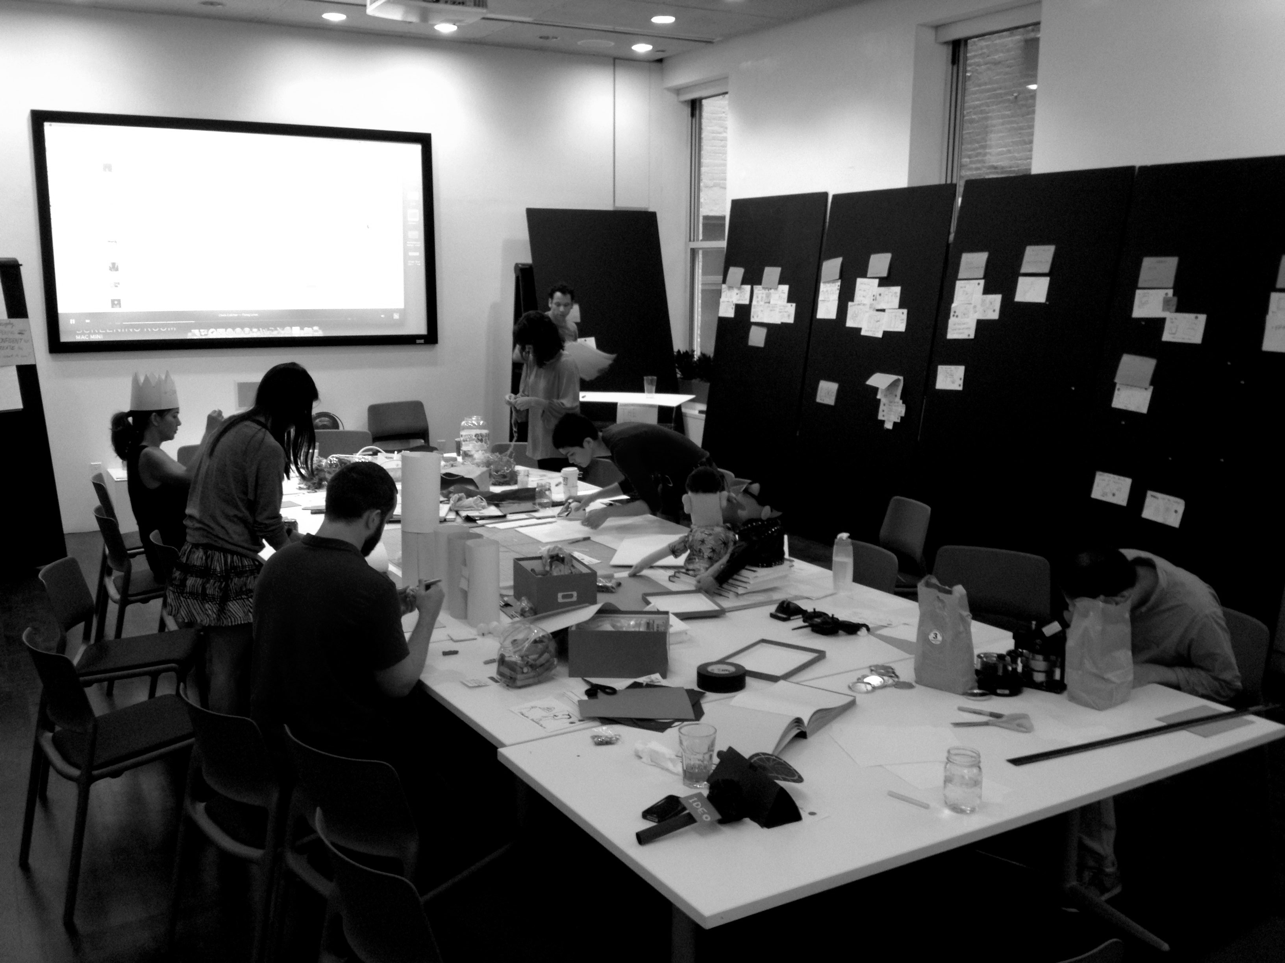
brainstorming

Slide 97
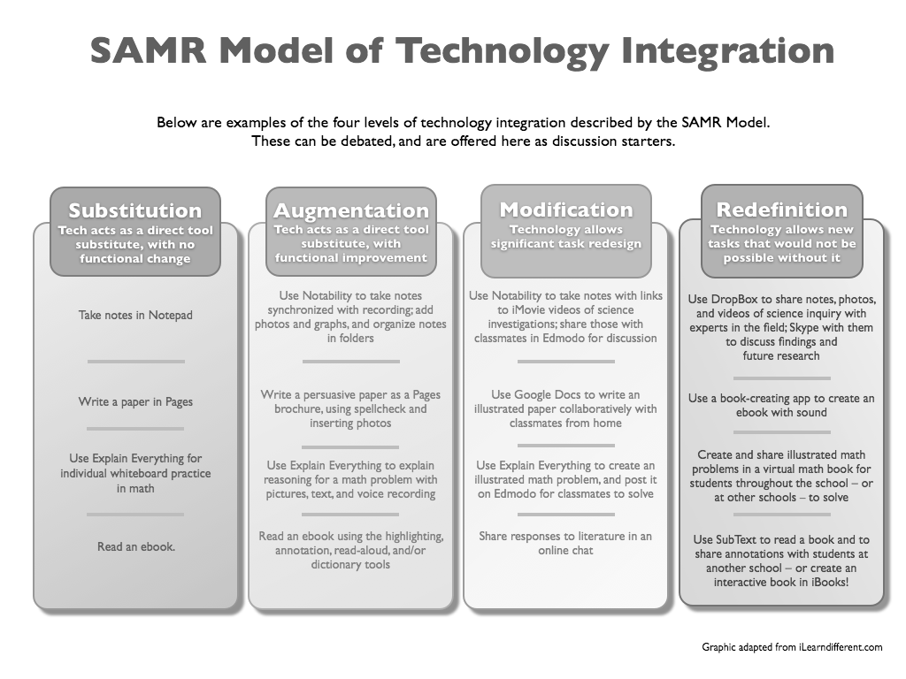

Slide 100
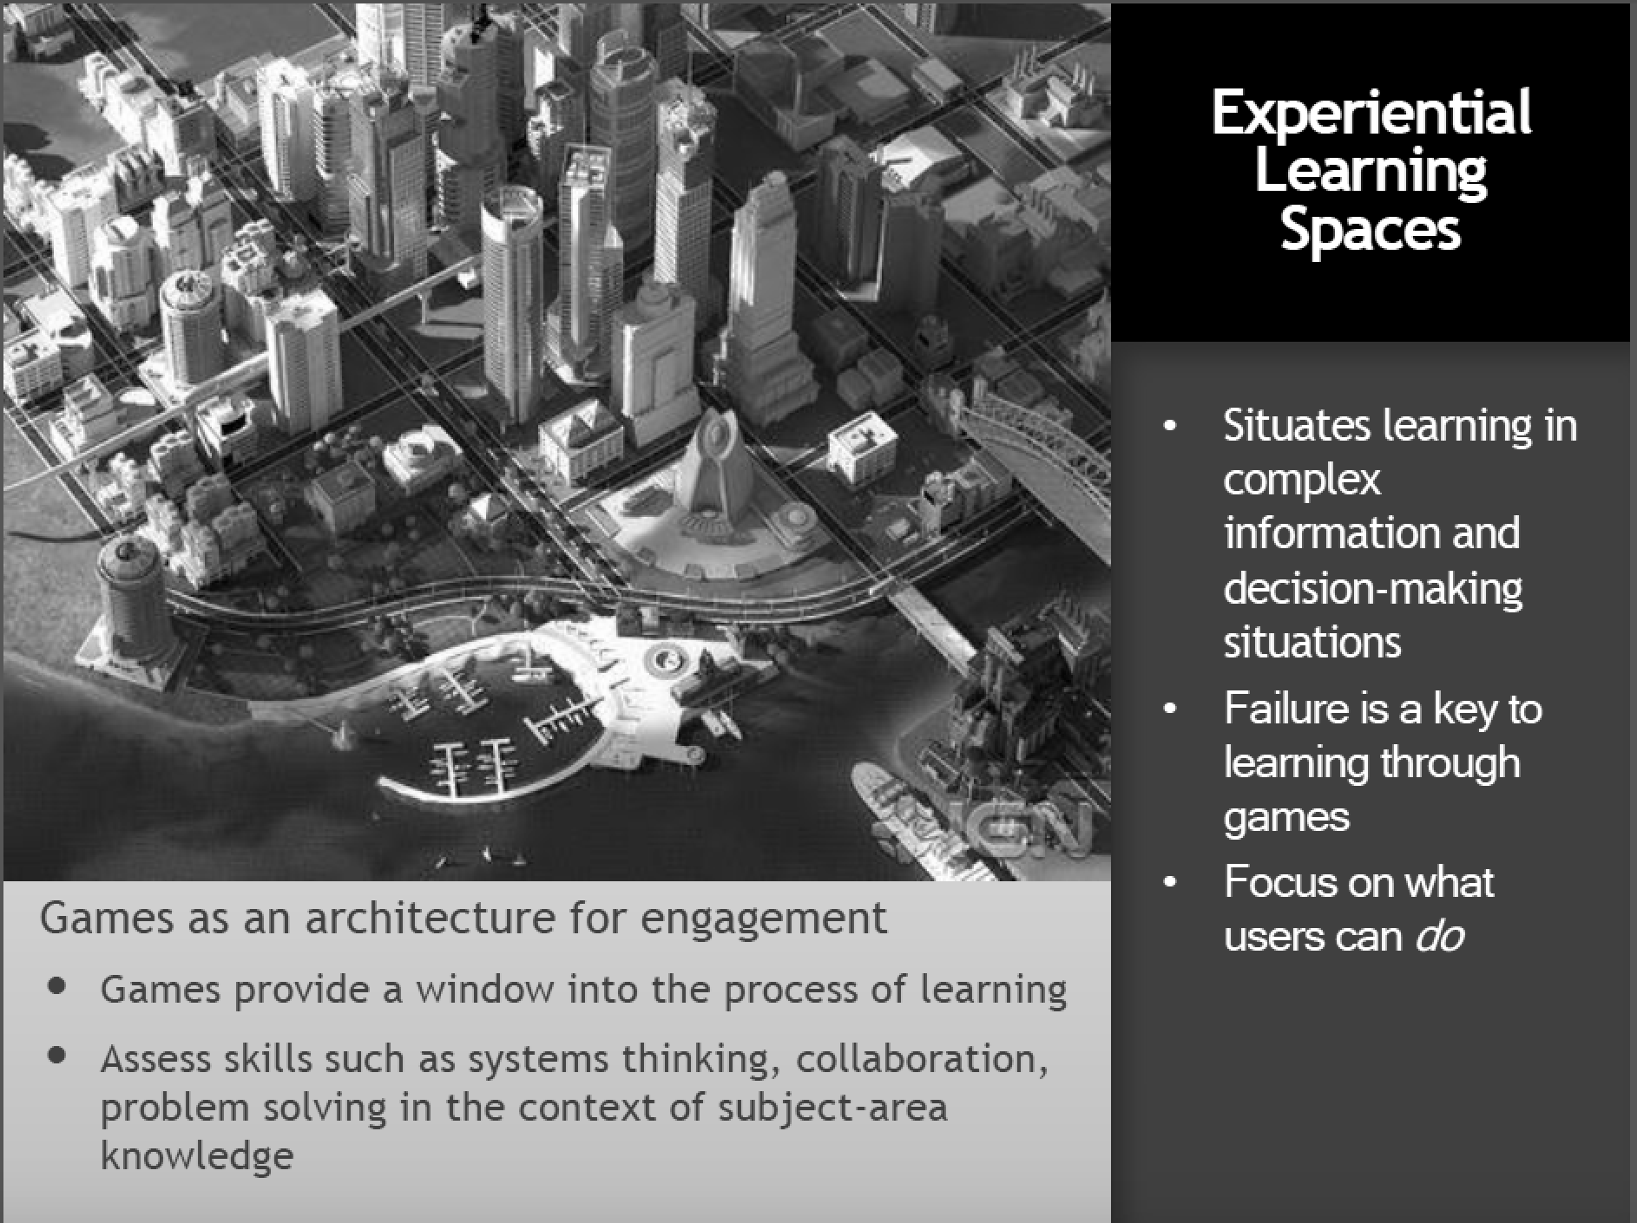
DR DIANA OBLINGER

Slide 101




competent
learning
person
from
Development
what we want to “CHANGE”…
final day
beginner
first day
achievement of student…

Slide 102


final day
what is the route like for our students from the first day to the final day?
how can we help them along the path?
what are the competences (knowledge, skills, and attitude) gap between each stage?
how do we know our students are ready for the next stage?
what is the specification of our academic and supporting staff?
who are our learners?
first day

Slide 103


nurture students for their life after college …
GOAL
of the programme

Slide 104


